Slide 1
Capstone Project
Hotel Booking Analysis Submitted by- Rinkesh Das Data Science Trainee, Almabetter Cohort Kaimur

Slide 2
Outline
Problem Statement
Data Exploration
Data Cleaning
Exploratory Data Analysis (EDA)
Conclusion

Slide 3


Hotel Industry
Hotel Industry is an important section of the service sector
that deals with guest accommodation and lodgings.
It includes hotels, motels, inns and guest houses.
Due to the nature of hotel services it is closely associated with
the travel and tourism industry.
The hotel industry consists of more than 15% of all the people
who worked in the hospitality sector.
According to Bureau of Labour Statistics ,hotel industry
employed over 1.8 million people in 2021. This industry
produces approximately 3-4% of the GDP in most of the
world economy and employ approximately 3% of the world’s
total labour force.

Slide 4

The hotel industry in India is expected to reach a value of INR 1,210.87 Bn. By the end of 2023, expanding at a compound annual growth rate of 13%.
In FY 2020 39 million jobs were created in the tourism sector in India, which was 8% of the total employment in the country.
So, it becomes essential to analyze the various factors involved in the growth of a hotel in the industry. In order to do that we take the help of the data generated in the hotel which includes various categories associated with the arrival and accommodation of guests in the hotel.
A detailed analysis of the data helps us to understand and ensure the growth of a Hotel.

Slide 5
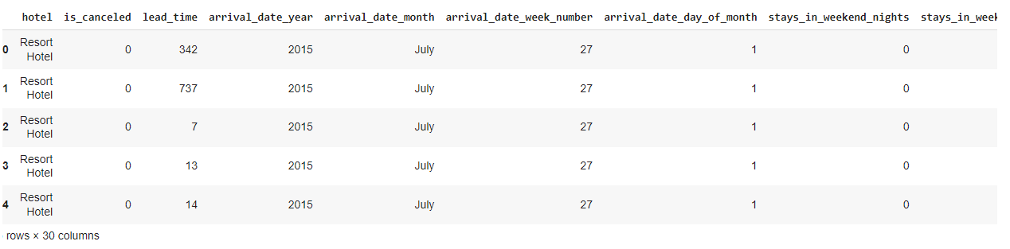
Data Exploration
The first step towards analyzing data is to know about the data and its contents.

Slide 6
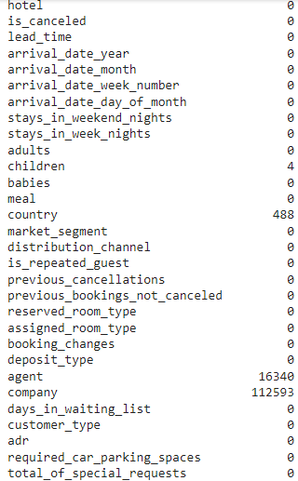
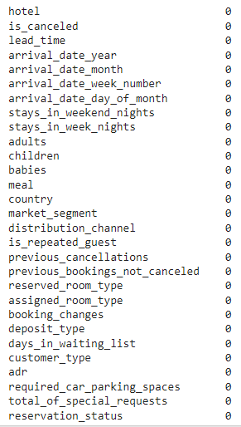
Data Cleaning
The data contains some null values which distort the data so the data needs to be cleaned before analysis.
Before Cleaning
After Cleaning

Slide 7
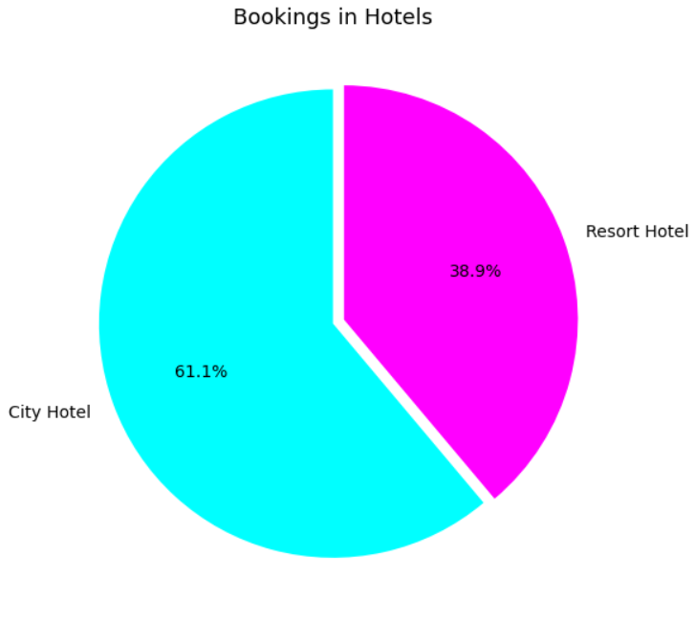
Data Analysis
1) Comparison between Hotels
Number of Bookings in Hotels.
We see that about 61% of the bookings were made in City Hotel and about 39% were made in Resort Hotel.
Thus we see that customers prefer City Hotel over Resort Hotel.
The reasons for this will be clear upon further analysis.

Slide 8
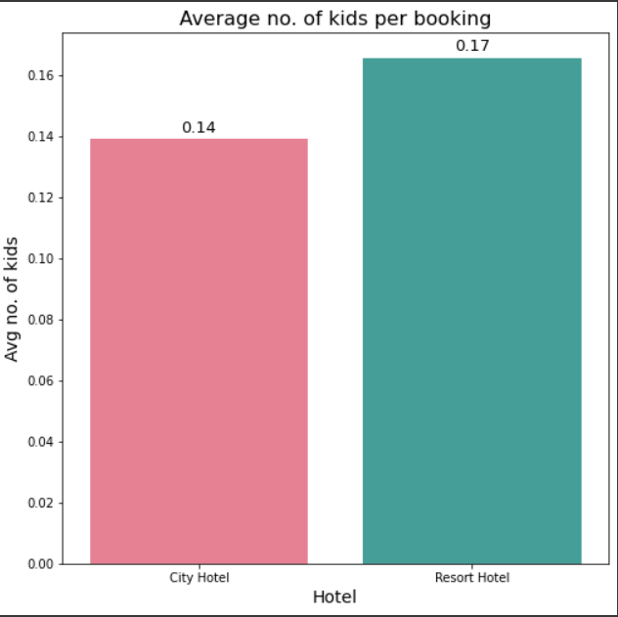
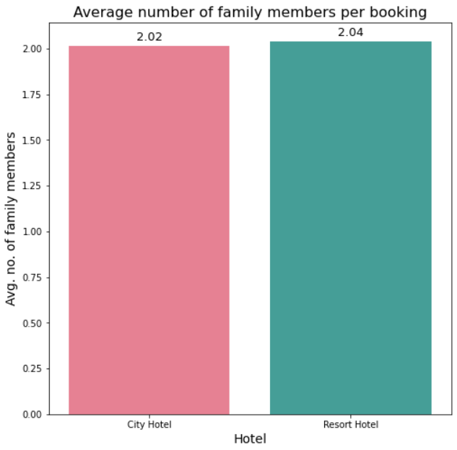
On further analysis we observe that the average number of kids per booking is higher for Resort Hotel.
Also the average number of total family members per booking is higher for Resort Hotel.
Thus, customers prefer Resort Hotel when the number of members in the family are more.
The high average number of kids per booking for Resort Hotel shows that customers with kids prefer Resort Hotel over City Hotel. This might be because Resort Hotel is more child friendly.

Slide 9
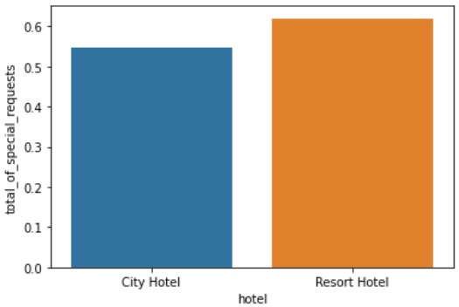
2) Special Requests made by the guests
Sometimes there are some special requests made by the guests during the stay. Hotels that try to fulfill these requests are more favorable.
It is observed that the average no. of special requests made in a booking is higher for Resort Hotel.

Slide 10
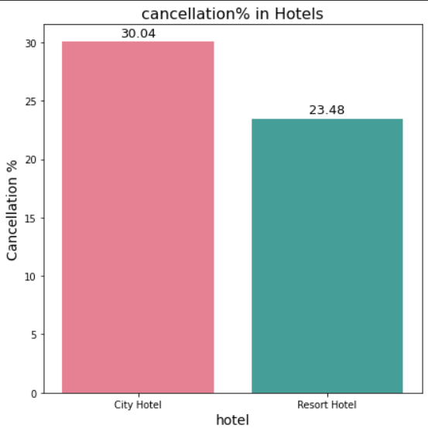
Booking Cancellation percentage
It is observed that about 23% of the bookings are cancelled in Resort Hotel and about 30% of the bookings are cancelled in City Hotel.
Cancellation of bookings have an adverse effect on the profit which in turn affects the growth of the hotel badly.

Slide 11
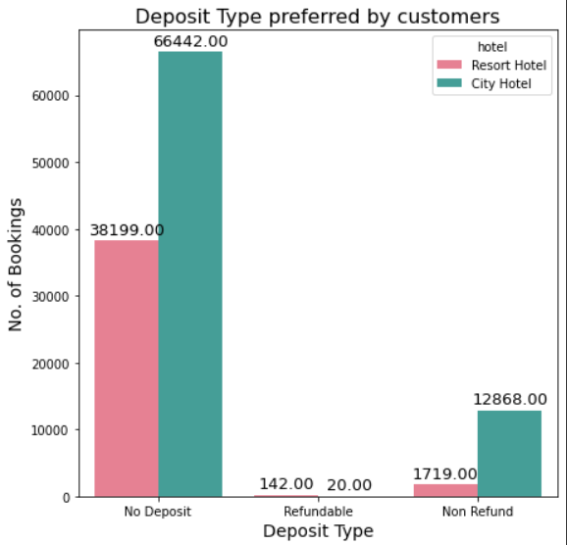
Deposit Policies of Hotel
We observe that most of the bookings are made without any deposit for both the hotels.
This means no advance payment is made prior to the check in of the guest.
Due to this it is very convenient for the guests to cancel the booking as and when they like. This is a major reason behind the high cancellation rates for the hotels.
To tackle this, an alternate deposit policy should be implemented so that unreasonable cancellations can be prevented.

Slide 12
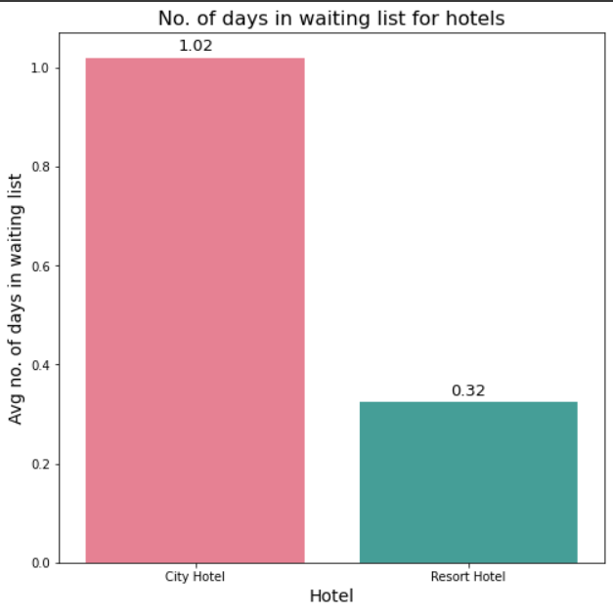
5) Waiting Time for Customers
Bookings are put in the waiting list for various reasons. One of the main reasons is lack of vacant rooms. Waiting time generally reflects that the hotel is receiving a good number of bookings. This also might be a deciding factor for the choice of hotels for a customer.
It is observed that the average waiting time for a booking is more in case of City Hotel. This might be due to the high number of bookings in the hotel.

Slide 13
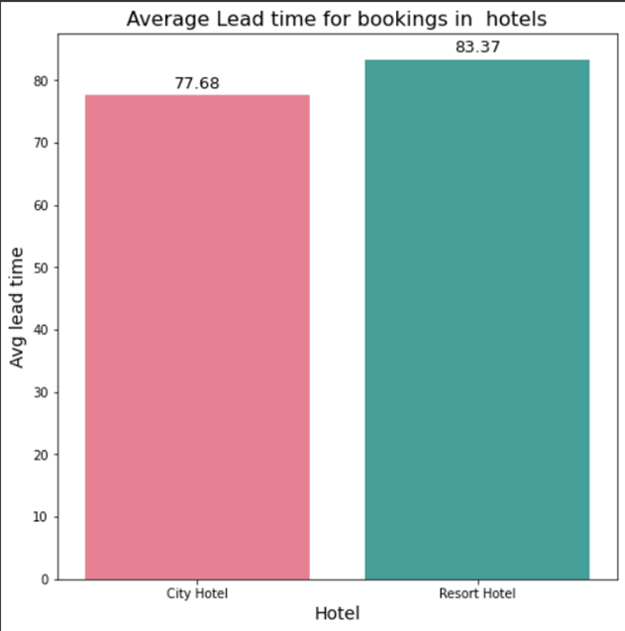
6) Lead Time for Customers
Lead time refers to the time interval between the booking and arrival of the guest. More lead time suggests that the Hotel remains mostly full and so guests have to make advance bookings.
It is observed that the average lead time for a booking is more in case of resort Hotel. This might be due to the high number of bookings in the hotel.

Slide 14
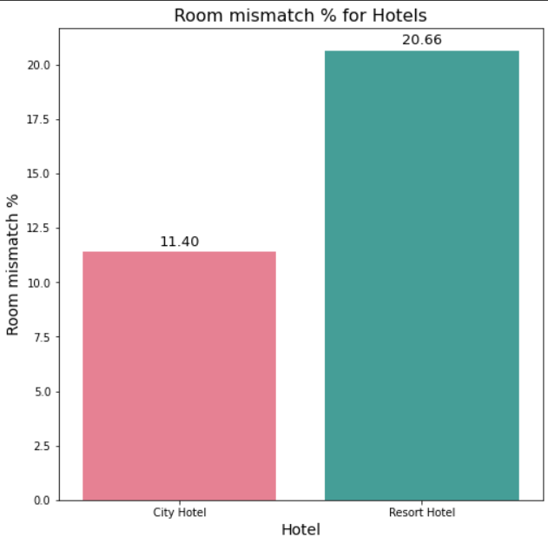
7) Rooms mismatch in hotels
When the customer books a room in a hotel he/she specifies the type of room he/she wants. Sometimes due to some reasons a different room type is assigned to the customer which leads to dissatisfaction.
It is observed that Resort Hotel has higher room mismatch percentage as compared to City Hotel.

Slide 15
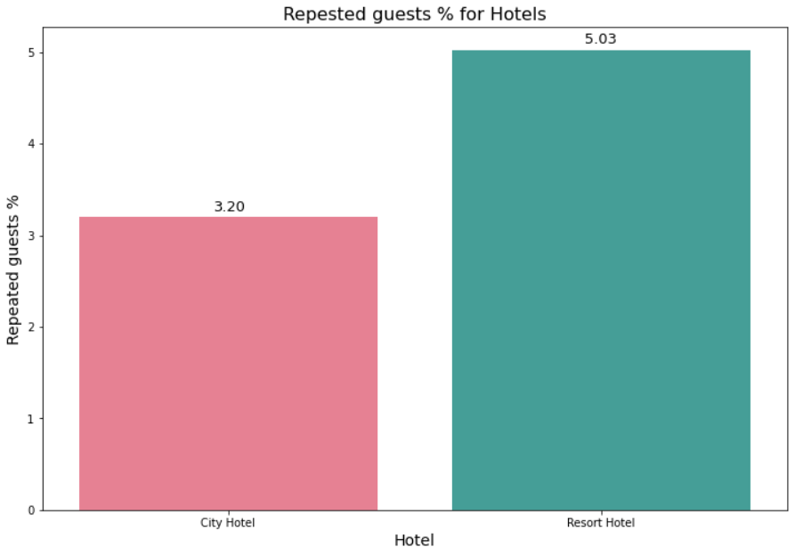
8) Repeat guest % in hotels
When a hotel provides satisfactory service the customers tend to come back to the hotel frequently. This increases the Repeat guests %. This is a sign of good service of the Hotel.
It is observed that Resort Hotel has a higher Repeat guests % than City Hotel.

Slide 16
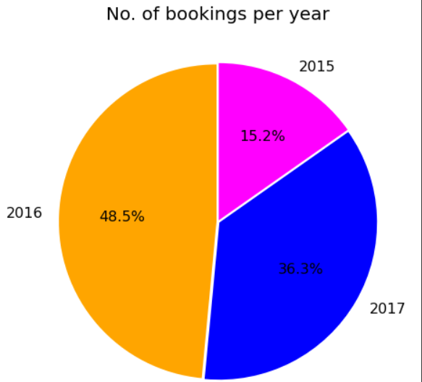
Distribution of bookings
(a) Distribution w.r.t years
Analysis shows that about 48% of the bookings were made in the year 2016 followed by 2017 with 36% and the least number of bookings were made in 2015 (about 15%).
Thus 2016 proved to be a favorable year for the hotels.

Slide 17
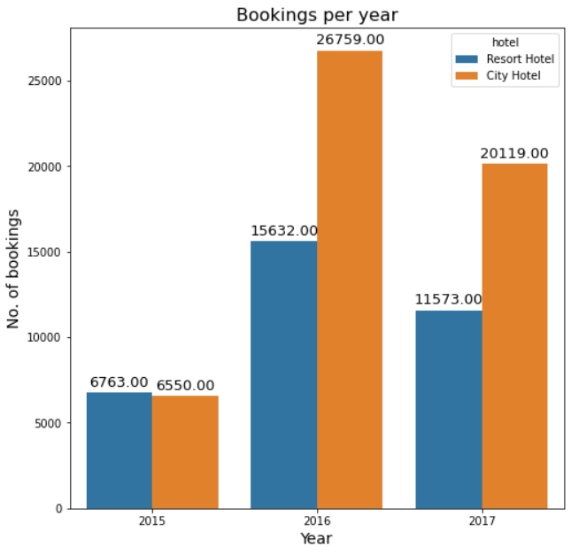

Slide 18
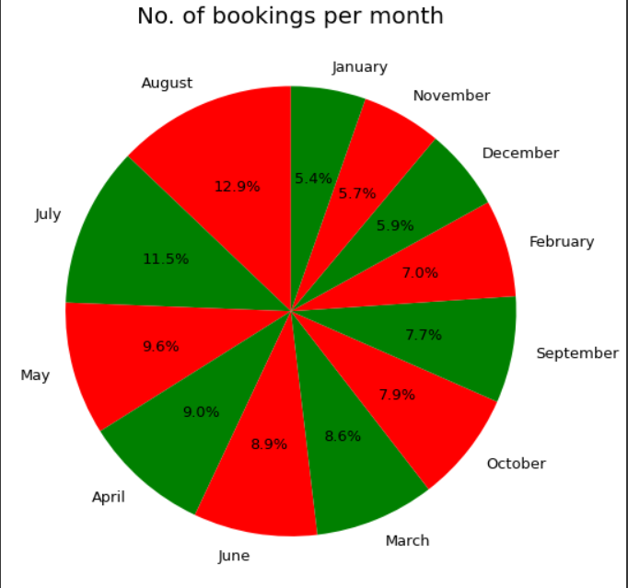
(b) Distribution w.r.t months of a year
We observe that the most number of bookings in a year were made in August (about 13%) followed by July(about 11%) and the least number of bookings were made in January(5%).
Thus August seems to be a favorable month for the hotels.
Further we will try to observe this data with respect to different hotels.

Slide 19
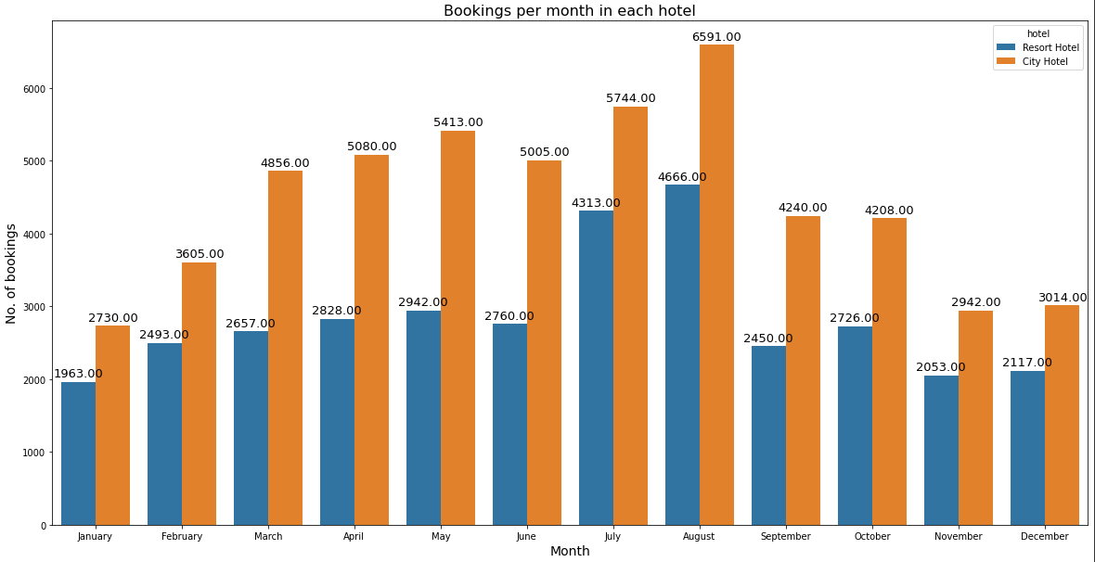
Here too, we observe the same thing that for both the hotels, August and January are the most and the least favorable months respectively.
Thus the hotels need to come up with some offers and schemes during the month of January to increase engagement with customers.
This will boost the number of bookings and thus the profit of the hotels will also increase.

Slide 20

Distribution of Average Daily Rate (ADR)
ADR is metric widely used in the hospitality industry to indicate the average revenue earned by the hotel for an occupied room.
ADR= (Room Revenue) / (Rooms sold).

Slide 21
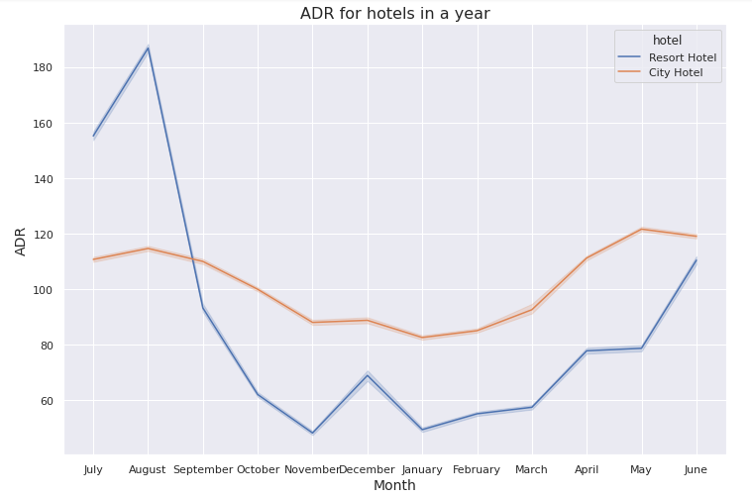
a) ADR w.r.t. to the months in a year
It is observed that the highest ADR for Resort and City Hotel is in the month of August and May respectively.
It can also be observed that the Hotels have low ADR in the months of November and January.

Slide 22
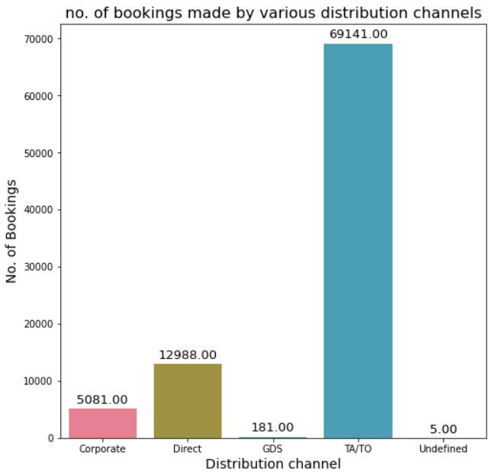
Distribution channels
Distribution channels preferred by customers
It can be observed that most of the bookings were made through TA/TO i.e. Travel agencies.
Thus the Hotels can contact the Travel agencies for endorsing their hotels through them.
This will help them attract more customers and in turn increase their revenue.

Slide 23
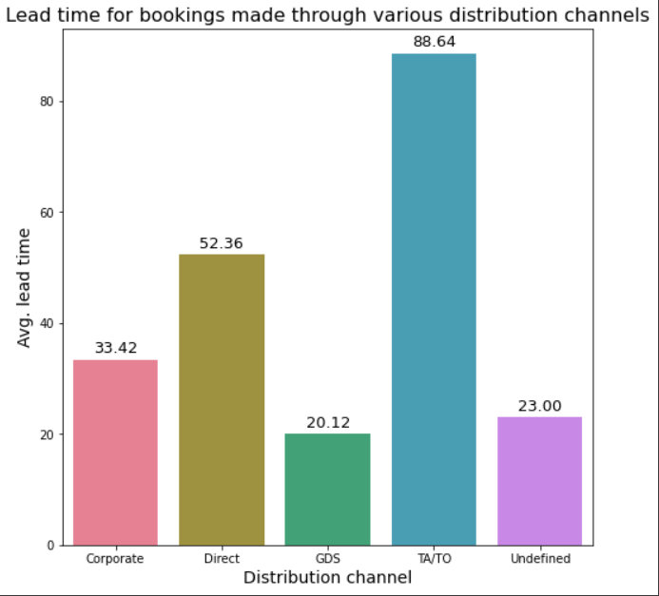
It is observed that TA/TO have the highest lead time whereas GDS has the lowest lead time.
Thus, we can say that advance bookings are made through TA/TO. Customers who make early bookings prefer TA/TO but for urgent bookings GDS is preferred.

Slide 24
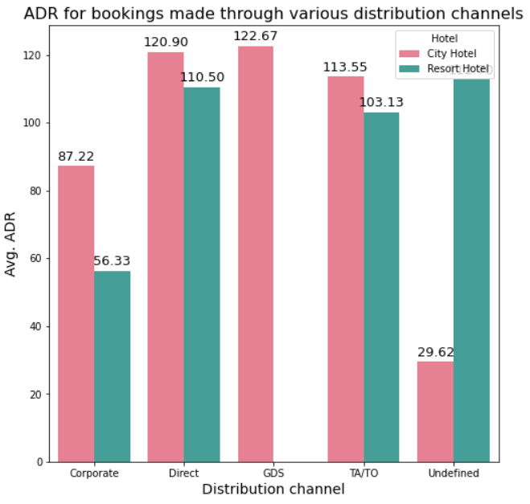
b) ADR w.r.t. to distribution channels
It was observed that City Hotel earns the highest ADR if the bookings are made through GDS.
Resort Hotel earns the highest ADR if the bookings are made through Direct distribution Channel.

Slide 25
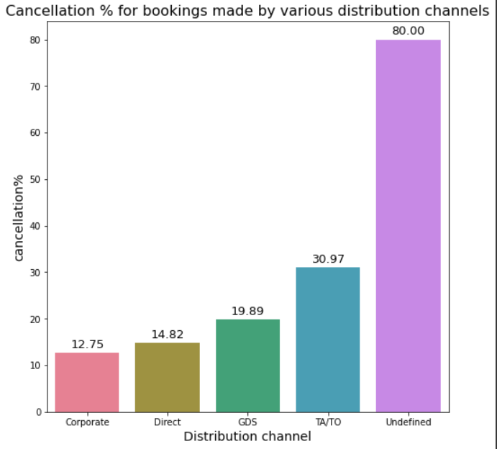
It was observed that the cancellation % of the bookings made through TA/TO is the highest.
Thus the bookings made through TA/TO s are more likely to be cancelled.
This might be due to the high lead time for the bookings made through this distribution channel.

Slide 26
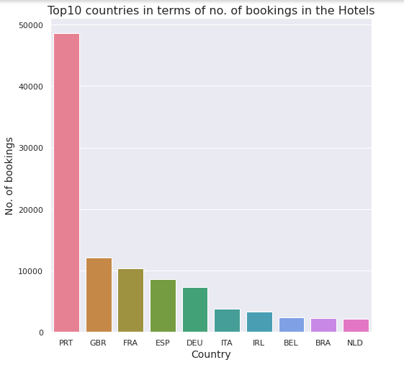

Countries from which bookings are made
International tourists always add to a hotel’s reputation and also overall promotion.
From the data, it is observed that most number of guests come from Portugal, followed by Britain and France and so on.

Slide 27
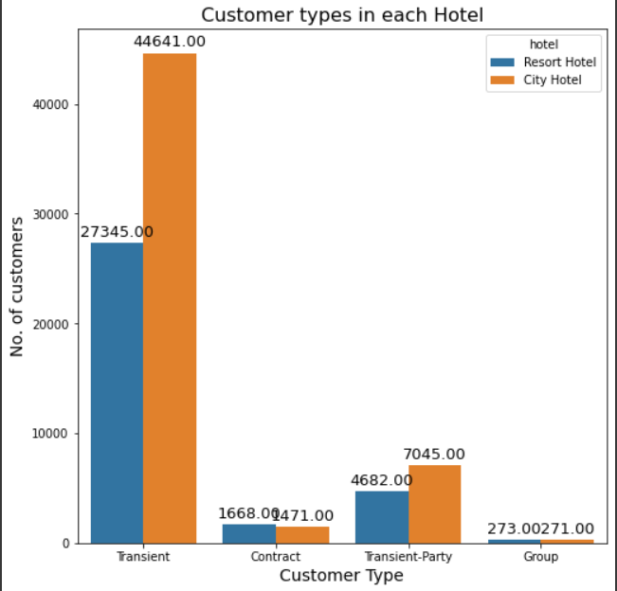
Customer types
We see that majority of the customers for City Hotel ( around 45000) as well as Resort Hotel (around 27000) were Transient.
This means most of the customers were tourists or travelers.

Slide 28
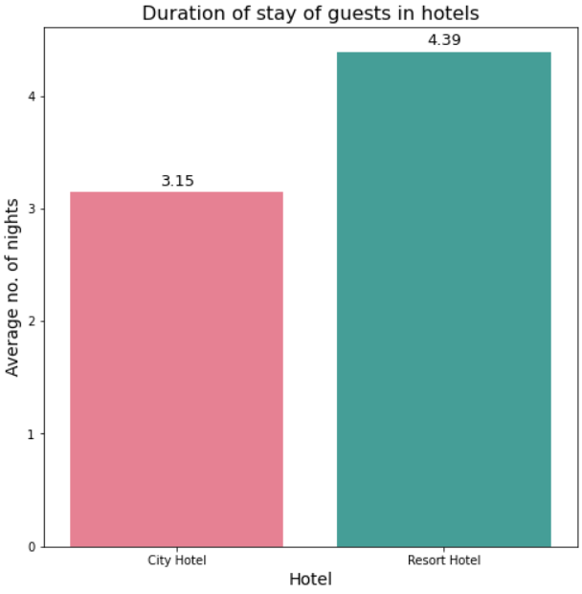

Duration of Stay for Customers in the Hotels
It is observed that customers who want to spend more nights opt for Resort Hotel.
Thus, Resort Hotel is more suitable for a long stay as compared to City Hotel.

Slide 29
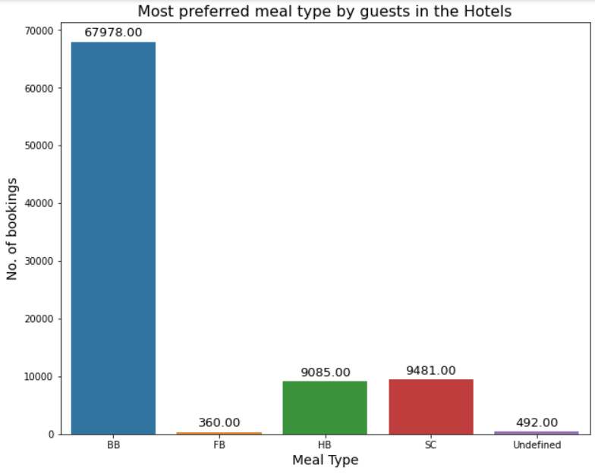
Food Choices of the guests
There are various meal choices available in Hotels and those choices determine the per day price of stay in that particular hotels for the guests.
It is observed that most of the guests opt for Bed and Breakfast(BB) followed by Half Board (HB) meal type.

Slide 30
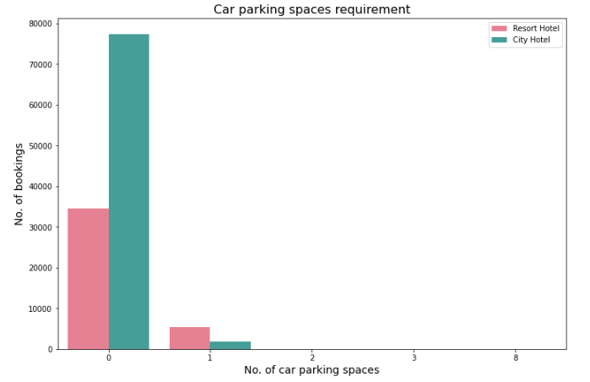
Car Parking Spaces Requirement
Guests, while making a booking in a hotel have a choice of opting for a carparking space in the Hotel.
From the data, it is observed that most of the guests in both the hotels did not opt for a car parking space. This suggests that most of the guests were tourists.

Slide 31
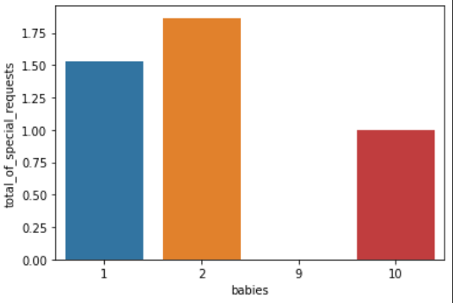
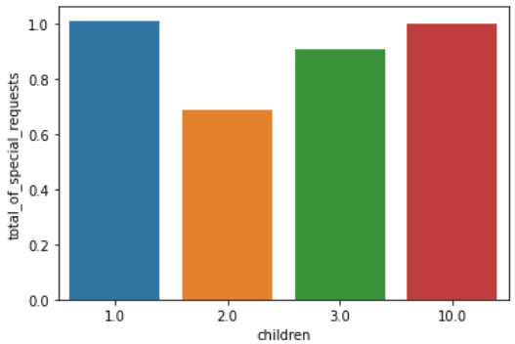
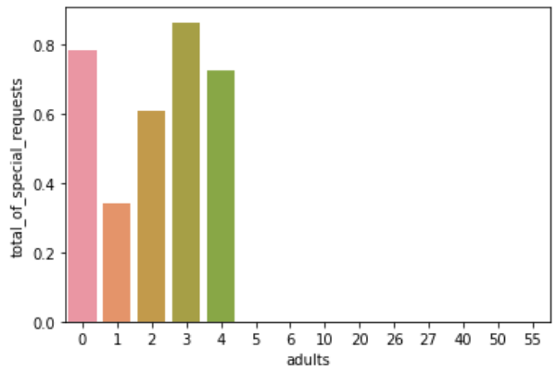
Special requests depending on the type of members in the guests
It is observed that the average number of special requests is the highest when there are babies with the guests followed by children and the least number of special requests are made when the guests are adults.

Slide 32
Conclusions
Customers prefer Resort Hotel when the number of members in the family are more.
Customers with kids prefer Resort Hotel over City Hotel.
City Hotel has greater cancellation % as compared to Resort Hotel.
Majority of the bookings are made with no advance payment made prior to the check in of the guest.
Most number of bookings were made in 2106, followed by 2017 and the least number of bookings were made in 2015.
Most number of bookings were made in the month of August and the least number of bookings were made in the month of January.

Slide 33
Conclusions
Most of the customers were tourists or travelers.
Most of the bookings were made through travel agents.
Also, Travel agents have the highest lead time so in case of urgent bookings GDS is preferred.
Bookings made through travel agents are more likely to be cancelled.
The highest ADR for Resort and City Hotel is in the month of August and May respectively.
Resort Hotel is more suitable for a long stay as compared to City Hotel.
The average waiting time for a booking is more in case of City Hotel.
Most number of guests come from Portugal, followed by Britain and France.

Slide 34
Conclusions
Most of the guests opt for Bed and Breakfast(BB) followed by Half Board (HB) meal type.
The average no. of special requests made in a booking is higher for Resort Hotel.
The average number of special requests is the highest when there are babies with the guests followed by children and the least number of special requests are made when the guests are adults.
Resort Hotel has higher room mismatch percentage as compared to City Hotel.
Most of the guests in both the hotels did not opt for a car parking space. This suggests that most of the guests were tourists.

Slide 35


